Slide 2
OUR PHILOSOPHY & FRAMEWORK

Slide 3
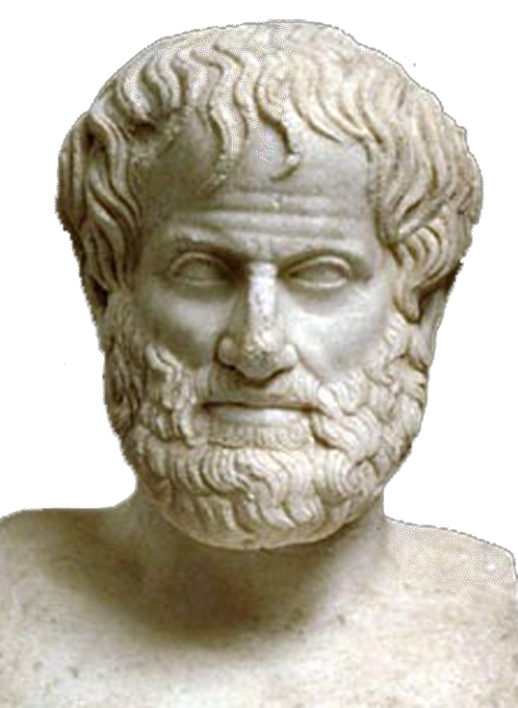
high performing teams - habit forming!
“We are what we repeatedly do. Excellence, then, is not an act, but a habit.”
Aristotle

Slide 4
DEFINITION OF A TEAM
  “a team is a small number of people with complementary skills who are committed to a common purpose, performance goals and approach for which they hold themselves mutually accountable.”
    Katzenbach & Smith
    The wisdom of teams

Slide 5
teams: performance “lever” of an organization
They consistently achieve exceptional results that exceed individual performance.
They are passionate about exceptional results.
We believe conscious high-performing teams understand that exceptional sustainable results come from integrating three criticaldimensions: IT (task), WE (relationships) and I (self).
IT
Task
Its members love working and having fun together. They have a passion for learning.
They are role models: they represent the best of the organizational culture.
We Interpersonal
I
Individual
They allow the full expression of their team members talents
They create a safe space of belonging and for making a significant contribution.

Slide 6
FRAMEWORK
  Our beliefs on leadership team effectiveness:
  We focus on helping leadership teams drive business performance improvement, rather than “teaming for teaming’s sake”.
  We uniquely combine work on “Hard - structure” and “Soft - behavior and culture” in our work with teams.
  Some of our fundamental philosophies for senior leadership teams are:
  Business objectives drive the optimal structure (teams, sub-teams) and process (meetings, roles) of leadership teams. Leadership Teams don’t always need to be teaming more; sometimes they should be teaming less, and/or more effectively. The key is to make disciplined choices about when and how to work together.
  Efforts to improve team effectiveness should be anchored to an actual business performance challenge(s). This improves team effectiveness in realistic situations, and ensures real progress on a business imperative, which in turn makes the new behaviors sustainable.
  Teaming improvements come from reviewing and adapting not just the team’s structure and process, but also its culture – as determined by the behaviors and the underlying mindsets of its members.

Slide 7
Supporting teams for sustained peak performance
We help teams ensure that they follow an effective meeting process: before (clear purpose and materials preparation), during (disciplined divergence and convergence process for authentic and effective conversations) and after (clarity of outcomes and accountability for next steps).
Through interviews and quantitative assessment, we produce a team diagnostic report with recommendations to improve performance
Team Diagnostic
Meeting Facilitation
Skill Building
Leaders understand how their mindsets impact the way they behave and lead. More effective mental models are explored and skills developed. Leaders feel empowered as they focus on their ability to respond rather than on external variables. They reconnect with a sense of meaning and purpose as they find ways to express their values in business-effective ways. They learn how to elicit the best in their teams and employees, creating genuine engagement and leading to superior performance.
We conduct skill building workshops specific to the team’s key issues as per diagnostic recommendations. The workshops are complemented with individual development sessions and team activities like meeting facilitation.
Individual Development
Notes:
this is what currently appears on the website

Slide 8
not all groups are teams…
Working Group
  Strong, clearly focused leader
  Individual accountability
  The only existing purpose is the broader organizational mission
  Individual work products
  Runs informational meetings
  Measures its effectiveness indirectly by its influence on others (such as financial performance of the business)
  Discusses, decides, and delegates
Team
  Shared leadership roles
  Individual and mutual accountability
  Specific team purpose that the team itself delivers
  Collective work products
  Encourages open-ended discussion and active problem-solving meetings
  Measures performance directly by assessing collective work products
  Discusses, decides, and does real work together
A team is a small number of people with complementary skills who are committed to a common purpose, set of performance goals, and approach for which they hold themselves mutually accountable.
Notes:
https://hbr.org/2005/07/the-discipline-of-teams

Slide 9
choosing the level of interdependency
A high performance team operates like a baseball team; according to the challenge presented members play in the field as a cohesive unit or they address challenges as individual batters…
The first step is to have absolute clarity on the team’s purpose; the scope of work will naturally derive from this purpose. High performance teams have the flexibility to adapt and the competency to understand whether to address each task as a workgroup or a team.
Sales
Business Strategy
People & Organization
Local execution
Budgeting
Best Practices
Long term vision
1
2
3
4
5
6
7
8
9
10
WORKGROUP
HIGH PERFORMANCE
TEAM
Swimming team
Baseball team
Soccer team
No need to assess tradeoffs
No interdependencies
No synergies (1+1=2)
Continuous assessment of tradeoffs
High interdependencies
High synergies (1+1>2)
Notes:
dont like this slide very much but helps make the point about choice of level of interdependency

Slide 10
example: football team objectives
Soccer team objective: | “Win, by scoring more goals than the other team”
Offense sub-team objective: Defense sub-team objective: | “Score goals” “Prevent the other team from scoring”
Offense team preferred play: Defense team preferred play: | Lose 4-5 or win 1-0? Lose 0-1 or win 5-4?
The team’s shared objective must outweigh individual objectives; sub-teams must sometimes sub-optimize in order to win as a team
Notes:
HANDOUT VERSION

Slide 11

high performance: consciousness + skill
mission / vision
exceptional sustainable performance
HAVE
results
visible
invisible
HIGHLY SKILLED
DO
behaviors
authentic communication
impeccable coordination
constructive negotiation
CONSCIOUSNESS
(flexible configuration)
BE
mental models, values & beliefs
unconditional responsibility
ontological humility
essential integrity
positive-sum
Notes:
not in current Team deck – we have a slide that has the 4 quadrant model and the teaming model. Rihci and I had many conversations about that slide and decided to change it cause it required a lot of explanation and we did not completely agreee with the teaming options that appeared there.

Slide 12

team diagnostic methodology details
The findings of our reports are based on a series of quantitative and qualitative data collected from all or a sample of team members and their collaborators:
  In-depth structured interviews: face-to-face or on-the-phone, with a certified Axialent coach
  To get their view on the culture of the team dynamic.
High Performance Team survey: online, administered to a sample of team members to be defined
  To measure the current level of effectiveness of BFF’s senior leadership team, based on their perspective;
  To collect their view on the desired culture focus for BFF, as well as organizational readiness and motivation for change.
Organizational Culture Survey (OCI)®: online, administered to a sample of team members to be defined
  To understand the shared behavioral expectations that operate within the organization (when the perspectives of multiple people are combined
Notes:
not in current Team deck

Slide 13
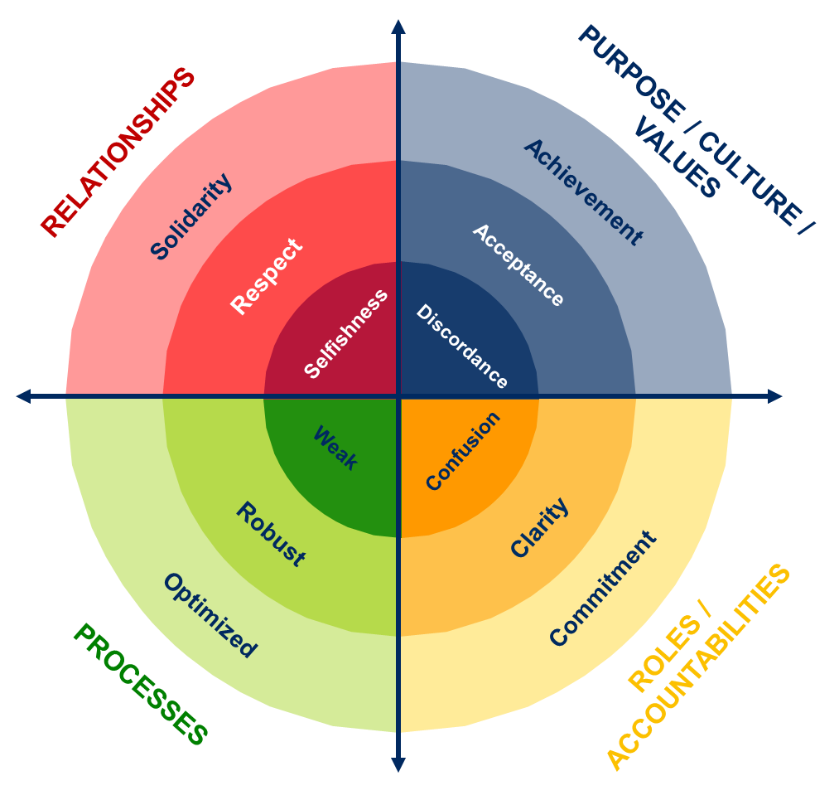
executive teaming success
1
Drive excellence on 4 key dimensions, starting with team purposes
2
Select and apply the correct “mode of teaming” against each team purpose
WORKING TEAM
Loosely assembled group structure
Often meets over extended period of time
REAL TEAM
Shared, shifting leadership
Shifting, evolving roles
Mutual accountability
Collective work products
SINGLE LEADER UNIT
Concentrated leadership
Clear, stable roles
Individual accountability
Individual work product

Slide 14
high performance team approach
High trust, support and challenge. Productive inquiry and active listening — willing to question, challenge, live with ambiguity and tension to transform and constructively negotiate in a way that supports agility and adaptive decisions and commitments. Members willing to be open and vulnerable in order to question and challenge themselves and others and
to grow.
High ownership for collective, shared purpose, visions and priorities. High aspiration and stretch. Team purpose trumps individual agendas. A culture that supports commitment to direction while being agile and adaptive along the way. A deep belief that challenging mindsets and beliefs are key aspects of strategy.
RELATIONSHIPS AND
INTERFACES
PURPOSE/CULTURE/
VALUES
Achievement
Solidarity
Respect
Acceptance
Selfishness
Discord
Weak
Confusion
Robust
Clarity
Clarity on roles, deliverables and independencies. High accountability. Willing to support team members for the greater good.
Decision-making, communication, delegation, teaming, and agendas that support agile and adaptive thinking.
Commitment
Optimized
ROLES/
ACCOUNTABILITIES
PROCESSES

Slide 15
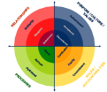
purpose, culture and values
HIGH PERFORMANCE TEAM 
Clear mission that generates a powerful shared purpose.
Breakthrough performance objectives come from within the team, not externally driven. Team self-motivated and challenges itself beyond external KPIs.
Walk the talk – each team member leads integral lives and calls upon other team members if they don’t.
Strategically planned teamwork - thought through the risks in the achievement of the team’s goals and have shared contingency plans.
Periodically review and update their team goals.
Striving for excellence; driving motto becomes: “Let’s see how good we can get!”
PURPOSE / CULTURE / VALUES
Achievement
Acceptance
Discordance
STANDARD TEAM 
Clear about the unique purpose of the team and how it supports organizational strategy.
Clear about the long term vision and values.
Clear about what goals the team needs to achieve; use specific commonly agreed upon measures.
Clear on shared priorities and how to achieve the team’s goals.
Have a defined code of value-based behaviors.
SUB-OPTIMAL TEAM 
Unclear or in disagreement about goals; non-existent, abstract or incongruent measures.
No shared vision or values.
No ground rules established.
No unique purpose of the team.
Unclear priorities and inability to make tradeoffs.
No idea on how the team purpose supports organizational strategy.

Slide 16
aligning purpose, behaviors & values
How aligned are the team’s purpose, behaviors and values?
From “each his own purpose” to “powerful shared mission”
shared purpose
What we want to accomplish as a team
From “optimizing the subsystem” to “optimizing the system”
HAVE
visibility
From “leading fiefdoms” to leading for synergy
leverage
behaviors
How our culture manifests as we realize our purpose in alignment with our values
DO
From “letting slide by” to “holding accountable for performance”
From “Let’s do it my way” to “I am curious about your way”
values
What we value in our business
BE
From “It’s your fault” to “How did I contribute?”

Slide 17
roles and accountabilities
HIGH PERFORMANCE TEAM 
Everyone is delivering their contribution and team expectations of each other are high – “my word is my bond”.
Mutual accountability and support – if one team member is falling, every member will help them to ensure success.
Make wise sacrifices and share resources to optimize the team effectiveness in service of the organizational goal.
Dedicated time to teambuilding and creating a sense of solidarity.
STANDARD TEAM 
Each role defined using the right metric and agreed to by all.
Interdependencies of individual roles are defined.
Individual contributions are defined and linked to team goals.
Each member’s contribution is aligned, via negotiation, with other team member’s contribution.
Individuals are accountable for their individual goals and for the team goals.|
Confusion
Clarity
SUB-OPTIMAL TEAM 
Roles are not defined. Overlaps and gaps create disruptions in the task performance and the relationships.
Individual contributions and interdependencies are not understood.
Commitment
ROLES /
ACCOUNTABILITIES

Slide 18
roles and accountabilities
CORE PRINCIPLES
  Negotiated contract between two parties
  My word is my bond
  Countable, tangible, visible
Being Accountable
1
Self set goals
Anticipating risk
Making promises
Planning
Personal responsibility
Managing risk
Keeping score
Keeping your word
Staying focused
Self motivation
2
3
Objective
The
Promise
Before the Promise
Transparent
After the Promise
Measures
Engaging others
Asking
Getting commitments
Influencing
Holding your ground
Keeping the heat on
Managing failure
Rewarding success
Holding Others to Account

Slide 19
process
HIGH PERFORMANCE TEAM 
Comfortably flex rules to become faster, more efficient (fit for purpose).
Unaware of impeccable coordination - processes are organic, not mechanistic.
Integrated processes that leverage cross-teaming synergies that transcend silos.
Disciplined attention to ongoing process improvement.
Minimalist, elegant, simple processes - a “more with less” essence.
Learning conversations & after action reviews [AAR] following each project to extract lessons
Consensus on decision making process – everybody agrees decisions made.
STANDARD TEAM 
Effective team meetings – time is wisely used (right topics, right people), output and agenda for each meeting is clear and agreed upon.
Team members have the necessary information to contribute effectively.
Communication systems are appropriate (email, voicemail, meetings, etc.).
Mechanisms facilitate action and follow up.
Team members stay on purpose.
The team uses appropriate methods for decision making, problem solving, information sharing, brainstorming, etc.
Weak
Robust
Optimized
SUB-OPTIMAL TEAM 
Team’s interactions are unstructured and chaotic.
There is no defined output or agenda for team meetings.
Team members do not have the necessary information to contribute effectively.
Communication systems produce breakdowns.
No joint work product.
PROCESS

Slide 20
seamless processes
HIGH
I
decide
AUTOCRACY
Check-in & check-out
Effective agendas
Self facilitation
Clear roles
We discuss
I decide
Level of control
We discuss
We decide
We discuss
You decide
ABDICATION
You
decide
Decision
Making
Process
Effective
Meetings
LOW
Breadth of vision, skill, experience
HIGH
Coherent amount and frequency of meetings according to type of team and issues to be addressed.
Meeting cycle connected to business cycles.
Clarity on purpose of each meeting: informative, decision-making, planning, etc.
ORGANIC TEAM DYNAMICS (“FLOW”)
Agreed
Ground Rules
Clear ROB
Rhythm of
the Business
“We manage commitments impeccably”.
“Everybody supports agreements reached”.
“No hallway conversations”.
Etc.
Learning
sessions
After Action Reviews following key milestones & projects.
Continuous improvement

Slide 21
relationships
HIGH PERFORMANCE 
No undiscussables - everything on the table: performance, agreements and self-disclosure.
Emotional mastery - comfortably use personal emotions, mind-sets and values to deliver desired results.
Productive inquiry and active listening - willing to question, challenge, live with ambiguity and tension to transform.
Forgiveness as a way of living 100% in the present.
Consciously deepen trust between each other - team members are seen as friends.
Attracts talent: people want to be on the team.
Team members protective of their “We” and are reluctant to transfer.
RELATIONSHIPS
Solidarity
Respect
Selfishness
STANDARD TEAM 
Mutual learning model helps understand own and other team member’s style, likes, dislikes, motivations, etc.
Differing viewpoints are spoken & heard. Give and receive feedback on behavior.
Active listening - respect and use differences of opinion, style and strengths.
Build each other’s contribution and draw out the best from everyone.
Trust in each other’s competence, dependability and support.
Team members are advocates of the team to others.
SUB-OPTIMAL TEAM 
Shallow politeness covering mistrust and lack of community.
Silo-focused individuals are concerned only with self-promotion, lack of care for one another.
Transactional exchanges no deep conversations about purpose and meaning.

Slide 22
relationships
A crisp purpose, clear roles and seamless processes need a solid human dimension for the team to achieve exceptional results over time.
achievement
impersonal
IT
business results
effectiveness
productivity
exceptional
sustainable
results
interpersonal
WE
trust
solidarity
mutual respect
personal
I
happiness
health
flow
Effective communication
No undiscussables
Deconstructive feedback
Generative negotiation
Impeccable commitments
Mental models
Unconditional responsibility
Learner attitude
Essential integrity
community
actualization

Slide 23
possible strategies
DIMENSIONS | FOCUS… | CONTENT…
PURPOSE AND GOALS | Purpose, behaviors and values alignment Strategic direction alignment | MISSION, VISION AND PURPOSE GOAL ALIGNMENT
ROLES | Accountability Team cohesiveness | IMPECCABLE COMMITMENTS
PROCESS | Processes in place Meeting effectiveness Cross-group collaboration | OPERATIONAL AGREEMENTS DECISION-MAKING PROCESS
RELATIONSHIP | Team interactions Levels of trust, communication and openness | AUTHENTIC COMMUNICATION DEALING WITH UNDISCUSSABLES TAKING TRUST TO THE NEXT LEVEL

Slide 24
possible strategies
DIMENSIONS | FOCUS… | CONTENT…
PURPOSE AND GOALS | Purpose, behaviors and values alignment Strategic direction alignment | MISSION, VISION AND PURPOSE GOAL ALIGNMENT
ROLES | Accountability Team cohesiveness | Team RACI IMPECCABLE COMMITMENTS
PROCESS | Processes in place Meeting effectiveness Cross-group collaboration | OPERATIONAL AGREEMENTS DECISION-MAKING PROCESS
RELATIONSHIP | Team interactions Levels of trust, communication and openness | AUTHENTIC COMMUNICATION DEALING WITH UNDISCUSSABLES TAKING TRUST TO THE NEXT LEVEL

Slide 25
different situations call for different approaches
team situation | objectives - examples | recommended approaches
New team, need to form quickly | Accelerate familiarity, e.g., with style preferences Set shared norms and objectives right away Agree charter and roles | “Jump start” Offsite Work with style inventory e.g. MBTI Real work on objectives/charter with feedback based in style inventory Ongoing coaching as needed
Existing team, performance challenges | Review objectives and shortfalls Confirm need for and nature of collective performance Improve teaming disciplines e.g., results orientation, problem solving, accountability | Team Assessment survey Workshops and “learning into action” Results measurement and feedback Ongoing coaching as needed
Existing team, significant trust issues | Diagnose problems – personal, structural, both? (If structural/discipline: as above) Improve teaming behaviors e.g., conflict resolution Restructure team as needed | Team assessment survey and style inventory e.g. MBTI Diagnostic interviews Group and one on one interventions as indicated
Dispersed global leadership group | Ensure effectiveness of collaboration and interfacing even when not physically together Determine effective meeting/sub group structures | Organizational network analysis “Leadership Journey” (several options) Virtual teaming best practices

Slide 26
different situations call for different approaches
team situation | objectives - examples | recommended approaches
Temporary project team | Complete a specific project outside normal business parameters Work effectively with others outside own function and/or business unit | Change/transformation principles Project management tools Cross functional teaming disciplines
Junior level permanent team | Collaborate effectively on an ongoing basis | Simple one- to two-day workshops on teaming basics
Senior level leadership team | Learn to leverage time together – senior leadership teams seldom need to truly “team” and instead need to form different sub-groupings and influence other parts of the organization effectively Set the standard for the organization | Higher investment, longer “journeys” heavily based in doing real work together Stakeholder involvement Organizational network analysis to understand and leverage interfaces outside the team

Slide 27
OUR APPROACH FOR INCREASED VALUE AND IMPACT

Slide 28
TEAM APPROACH / SOLUTION OVERVIEW
Team assessment:
Meeting observation, online survey &
Interviews
Assess and
measure progress, debrief & recommendations
HIGH PERFORMING TEAM
Development of a plan and strategy for team development
Business meeting facilitation
Skill building
Coaching
Virtual and
digital tools

Slide 29

SOLUTION DETAIL
Diagnose & Plan
Execute
Review Progress
Alignment around individual & collective shifts
Individual development & practice
Collective development & practice
Learn, capture & adjust
Develop an accurate team diagnosis, easy to understand model, and strategic plan for change
Interviews (team members)
Latest Pulse Insights
High Performing team assessment
Co-design a journey for team leaders to help them “Lead by Example”.
High impact skill building and deployment of new mindsets and behaviors with LT.
Leadership Team sessions to:
  Realign shared values and desired leadership behaviors
  Develop new Protagonist/Player + Learner mindsets & skills for increased effectiveness
360° individual assessment (LSI® I & II):
  Individual LSI (life styles inventory) & comprehensive debrief sessions to see leadership impact on others and on the business
Individual application coaching sessions to:
  Learn and practice new skills and behaviors in a ‘safe’ environment
  Challenge oneself to adopt new mindsets, beliefs & mental models
  Provide deeper awareness of own development opportunities and way forward
Facilitated business meetings to:
  Help leaders internalize and implement(real-time) new interaction practices in their regular meetings and team activities, grounded in new culture and leadership model standards
Measure impact and progress.
Consultant feedback on team meeting dynamic after each facilitation
Impact analysis meeting
Individual follow up to gauge progress against personal improvement plans
Pulse results progress
Learn to continuously hold selves accountable and support/invite others to lead according to the new standards.

Slide 30
workshop interventions - examples
We can provide a wide variety of team interventions depending on the diagnosis. Common interventions include:
Team Charter / Stakeholder Analysis
Creating a vision/mission appropriate to business conditions
Goal Alignment
Aligning the goals of sub-teams and individuals to the overarching mission and cross linking them to each other
Team Structure
Deciding the best way to collaborate depending on the objective the team is working on (Efficient vs. Effective)
“Undiscussables” conversation
Raising issues that everyone knows, but no one is publicly saying
New Leader Assimilation
Helping a new team leader quickly integrate with the team
Innovative Problem Solving
Coming up with “out of the box” solutions through a structured process

Slide 31
collective development
BUSINESS MEETING FACILITATION
objectives
content and dynamic
format
Help leaders internalize and implement new interaction practices in their regular meetings and team activities, grounded in a new leadership model.
Improvement of structure and behavior of typical team meetings.
Development of enhanced conversational and team interaction practices, including commitment, listening, negotiation and conflict resolution.
Observation and facilitation of a few monthly meetings.
Suggestions for improvement by the Axialent facilitator.
In person if possible or by Zoom or other digital platform.

Slide 32
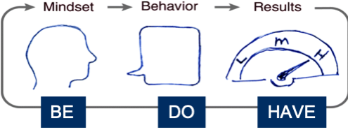
Conscious meeting facilitation
  Conscious meeting facilitation transforms the meeting experience into one of achievement and motivation.
  It means operating with a heightened awareness for mindsets and behaviors that impact a meeting’s outcomes. In fact, conscious meeting facilitation begins by establishing the right mindsets which in turn inform behaviors that result in more effective meetings.
  Conscious meeting facilitation helps people remain aware of their choices to adhere to these mindsets and behaviors.
  Conscious meeting facilitation means that every aspect of the meeting’s design and preparation, as well as its facilitation, is conducted from a place of awareness of multiple dimensions from the physical to the cognitive to the emotional, all to produce a specific desired business outcome. Let’s take a look at each of these dimensions.
Establishing Clear Mindsets, and Behavioral Expectations

Slide 33
Individual development
1:1 APPLICATION COACHING
objectives
content and dynamic
format
Provide deeper awareness of own development opportunities, impact on the team and a way forward.
Enable individuals to focus on effectiveness within the team setting.
Applications of new leadership skills and behaviors to daily business.
Connection of operational issues with individual’s objectives and values — a critical step to ensure real change.
Tailored dialogues and role-plays to experience new — and difficult — behaviors in a safe environment.
Establishment of operational “contracts” to ensure immediate real-life application.
One-hour sessions with a dedicated Axialent consultant.
By Zoom or Skype, or other digital platform.

